Slide 1
Chapter 8 Security

Slide 2
Chapter 8: Network Security
Chapter goals:
understand principles of network security:
cryptography and its many uses beyond “confidentiality”
authentication
message integrity
security in practice:
firewalls and intrusion detection systems
security in application, transport, network, link layers
8-2

Slide 3
Chapter 8 roadmap
8.1 What is network security?
8.2 Principles of cryptography
8.3 Message integrity, authentication
8.4 Securing e-mail
8.5 Securing TCP connections: SSL
8.6 Network layer security: IPsec
8.7 Securing wireless LANs
8.8 Operational security: firewalls and IDS
8-3

Slide 4
What is network security?
confidentiality: only sender, intended receiver should “understand” message contents
sender encrypts message
receiver decrypts message
authentication: sender, receiver want to confirm identity of each other
message integrity: sender, receiver want to ensure message not altered (in transit, or afterwards) without detection
access and availability: services must be accessible and available to users
8-4

Slide 5



Friends and enemies: Alice, Bob, Trudy
well-known in network security world
Bob, Alice (lovers!) want to communicate “securely”
Trudy (intruder) may intercept, delete, add messages
Alice
Bob
channel
data, control messages
secure
sender
s
data
secure
receiver
data
Trudy
8-5

Slide 6
Who might Bob, Alice be?
… well, real-life Bobs and Alices!
Web browser/server for electronic transactions (e.g., on-line purchases)
on-line banking client/server
DNS servers
routers exchanging routing table updates
other examples?
8-6

Slide 7
There are bad guys (and girls) out there!
Q: What can a “bad guy” do?
A: A lot! See section 1.6
eavesdrop: intercept messages
actively insert messages into connection
impersonation: can fake (spoof) source address in packet (or any field in packet)
hijacking: “take over” ongoing connection by removing sender or receiver, inserting himself in place
denial of service: prevent service from being used by others (e.g., by overloading resources)
8-7

Slide 8
The language of cryptography
Alice’s
encryption
key
Bob’s
decryption
key
K
K
A
B
plaintext
encryption
algorithm
ciphertext
decryption
algorithm
plaintext
m plaintext message
K_{A}(m) ciphertext, encrypted with key K_{A}
m = K_{B}(K_{A}(m))
8-8

Slide 9
Symmetric key cryptography
K
K
S
S
plaintext
message, m
encryption
algorithm
ciphertext
decryption
algorithm
plaintext
K (m)
m = K_{S}(K_{S}(m))
S
symmetric key crypto: Bob and Alice share same (symmetric) key: K
e.g., key is knowing substitution pattern in mono alphabetic substitution cipher
Q: how do Bob and Alice agree on key value?
S
8-9

Slide 10
Authentication
Goal: Bob wants Alice to “prove” her identity to him
Protocol ap1.0: Alice says “I am Alice”
“I am Alice”
Failure scenario??
8-10

Slide 11
Authentication
Goal: Bob wants Alice to “prove” her identity to him
Protocol ap1.0: Alice says “I am Alice”
in a network,
Bob can not “see” Alice, so Trudy simply declares
herself to be Alice
“I am Alice”
8-11

Slide 12
Authentication: another try
Protocol ap2.0: Alice says “I am Alice” in an IP packet
containing her source IP address
Alice’s
IP address
“I am Alice”
Failure scenario??
8-12

Slide 13
Authentication: another try
Protocol ap2.0: Alice says “I am Alice” in an IP packet
containing her source IP address
Trudy can create
a packet “spoofing”
Alice’s address
Alice’s
IP address
“I am Alice”
8-13

Slide 14
Authentication: another try
Protocol ap3.0: Alice says “I am Alice” and sends her
secret password to “prove” it.
Alice’s
IP addr
Alice’s
password
“I’m Alice”
Failure scenario??
Alice’s
IP addr
OK
8-14

Slide 15
Public Key Cryptography
symmetric key crypto
requires sender, receiver know shared secret key
Q: how to agree on key in first place (particularly if never “met”)?
public key crypto
radically different approach [Diffie-Hellman76, RSA78]
sender, receiver do not share secret key
public encryption key known to all
private decryption key known only to receiver
8-15

Slide 16
Public key cryptography
+
Bob’s public
key
K
B
-
Bob’s private
key
K
B
plaintext
message, m
encryption
algorithm
ciphertext
decryption
algorithm
plaintext
message
+
K (m)
-
+
B
m = K (K (m))
B
B
8-16

Slide 17
Digital signatures
cryptographic technique analogous to hand-written signatures:
sender (Bob) digitally signs document, establishing he is document owner/creator.
verifiable, nonforgeable: recipient (Alice) can prove to someone that Bob, and no one else (including Alice), must have signed document
8-17

Slide 18
Digital signatures
simple digital signature for message m:
Bob signs m by encrypting with his private key K_{B}, creating “signed” message, K_{B}(m)
-
-
Bob’s message, m
-
Bob’s private
key
-
K
m,K
(m)
B
B
Dear Alice
Oh, how I have missed you. I think of you all the time! …(blah blah blah)
Bob
Bob’s message, m, signed (encrypted) with his private key
Public key
encryption
algorithm
8-18

Slide 19
SSL: Secure Sockets Layer
widely deployed security protocol
supported by almost all browsers, web servers
https
billions $/year over SSL
mechanisms: [Woo 1994], implementation: Netscape
variation -TLS: transport layer security, RFC 2246
provides
confidentiality
integrity
authentication
original goals:
Web e-commerce transactions
encryption (especially credit-card numbers)
Web-server authentication
optional client authentication
minimum hassle in doing business with new merchant
available to all TCP (Transport control protocol) applications
secure socket interface
8-19

Slide 20
SSL and TCP/IP
Application
Application
SSL
TCP
TCP
IP
IP
normal application
application with SSL
SSL provides application programming interface (API) to applications
C and Java SSL libraries/classes readily available
8-20

Slide 21
Toy SSL: a simple secure channel
handshake: Alice and Bob use their certificates, private keys to authenticate each other and exchange shared secret
key derivation: Alice and Bob use shared secret to derive set of keys
data transfer: data to be transferred is broken up into series of records
connection closure: special messages to securely close connection
8-21

Slide 22
Toy: a simple handshake
hello
public key certificate
K_{B}⁺(MS) = EMS
MS: master secret
EMS: encrypted master secret
8-22

Slide 23
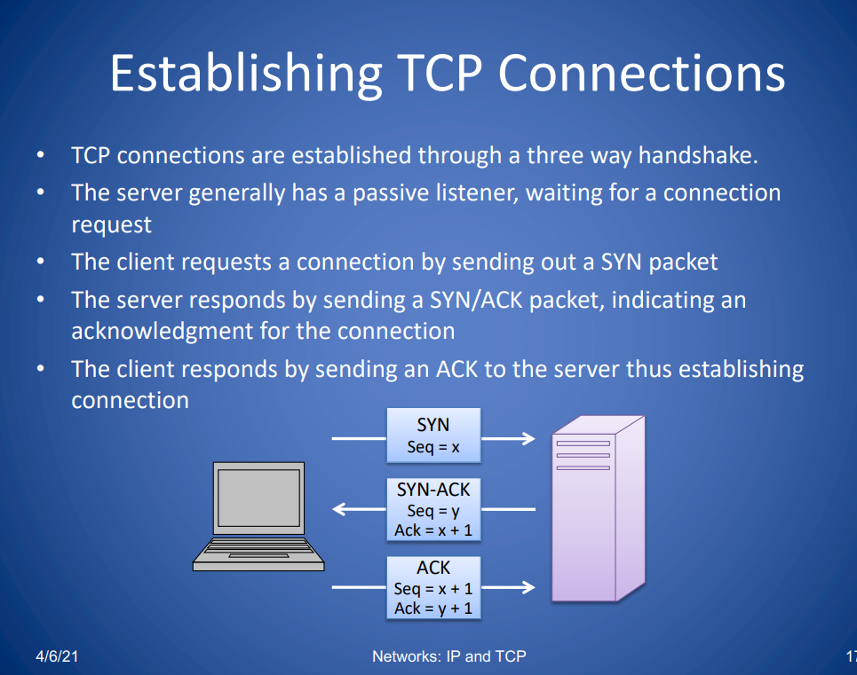

Slide 24
SSL cipher suite
cipher suite
public-key algorithm
symmetric encryption algorithm
MAC algorithm
SSL supports several cipher suites
negotiation: client, server agree on cipher suite
client offers choice
server picks one
common SSL symmetric ciphers
DES – Data Encryption Standard: block
3DES – Triple strength: block
RC2 – Rivest Cipher 2: block
RC4 – Rivest Cipher 4: stream
SSL Public key encryption
RSA
8-24

Slide 25
Firewalls
A firewall is a network security device (computer hardware or software) that monitors incoming and outgoing network traffic and permits or blocks data packets based on a set of security rules.
Its purpose is to establish a barrier between your internal network and incoming traffic from external sources (such as the internet) in order to block malicious traffic like viruses and hackers.

Slide 26


Firewalls
firewall
isolates organization’s internal net from larger Internet, allowing some packets to pass, blocking others
administered
network
public
Internet
trusted “good guys”
untrusted “bad guys”
firewall
8-26

Slide 27
Firewalls: why
prevent denial of service attacks:
SYN flooding: attacker establishes many bogus TCP connections, no resources left for “real” connections
prevent illegal modification/access of internal data
e.g., attacker replaces CIA’s homepage with something else
allow only authorized access to inside network
set of authenticated users/hosts
three types of firewalls:
stateless packet filters
stateful packet filters
application gateways
8-27

Slide 28
Good Videos
https://www.youtube.com/watch?v=sEkw8ZcxtFk

